Slide 1
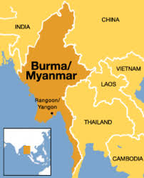
Myanmar (Burma)

Slide 2
My family in Myanmar

Slide 3
With Dad on the Mountain 2019

Slide 4
My Family in San Diego

Slide 5
Agape Myanmar Mission
Vision
“To plant the church (a house church, Discovery Bible Study Groups) in every village/city of Myanmar (Burma) by 2033”

Slide 6
According to Joshua Project
There are 149 people groups in Myanmar (Burma).
Out of 149 people groups, 53 people groups in Myanmar are still unreached.

Slide 7
According to 2014 Myanmar Census
More than 70 thousand villages in Myanmar
More than 70% of those villages do not have a believer, church planter or a missionary.

Slide 10
Training Myanmar Church Planters

Slide 12
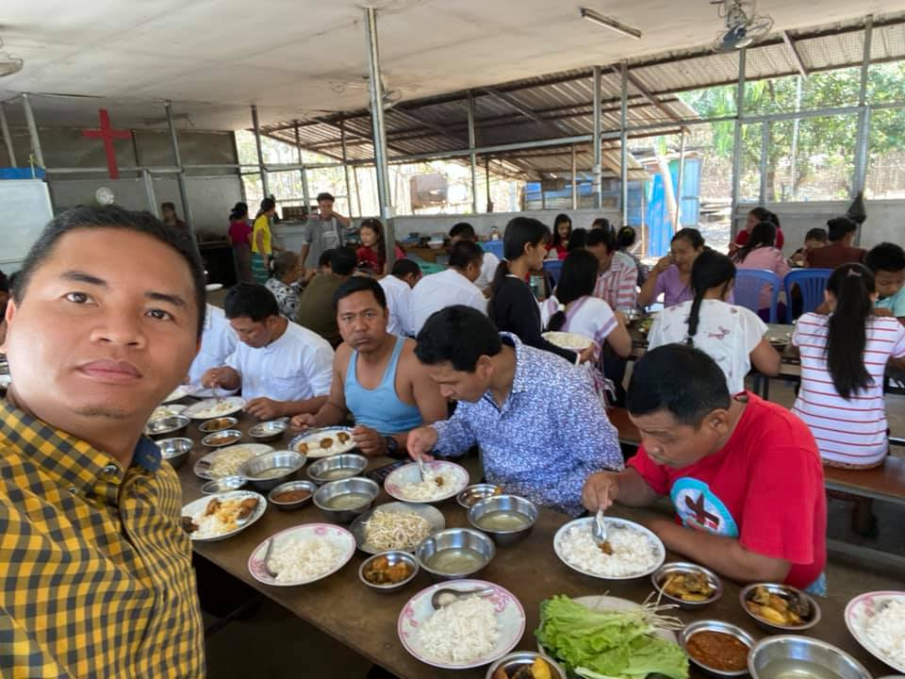

Slide 14
Providing Bible and Gospel Materials

Slide 16
San Diego Burmese Refugee Outreach

Slide 23
How you can partner with Agape Myanmar Mission?

Slide 24
Outreach/Mission Projects 2022
1. Myanmar (Burmese) Bible Project 2022 We are praying to fund 5000 copies of Myanmar (Burmese) Bible in 2022. The vision is to have a Discovery Bible Study Groups (House Church) in every village of Myanmar. Only the Gospel can transform the nations and bring us to Heaven. Right now the Myanmar people need the living God and His Word more than ever before.

Slide 25
2.Water Well Drilling Project in Myanmar 2022
Praying and aiming to fund 5- Water Well Drilling Project in the most needed dry area of Myanmar (Burma) where our partners are planting churches.

Slide 26
3. Thailand - Myanmar Border Mission Trip on July 26-August 19, 2022.
To provide Myanmar refugee families with all kinds of food supplies, medical supplies, clothing, Blanket, Rain coat and etc. We will pray, share the Gospel and start Discovery Bible Study Groups.

Slide 27
4. Back to School Refugee Community Outreach Project on August 27, 2022.
We will provide Backpack and School supplies to 400 refugee children in our community. There will be jumpers, Popcorn, BBQ, Games and Gospel presentation.

Slide 28
5. Myanmar Church Planters Training on Nov 22-25, 2022.
We will train 200 Myanmar church planters to fulfill the great commission in the country. We will provide accommodation, meal, Training Material, Book, Bible, Backpack, Notebook and return Bus ticket their mission field.

Slide 29
6. Christmas Refugee Community Outreach Project 2022
San Diego Refugee Community Christmas Outreach will be at Colina Park on December 17. We are going to provide daily needed food items, Hygiene Items, Bible Story, Gospel books and etc for 200 refugee families.
There will be Bounce houses, BBQ, Burmese Ethnic food, Popcorn, Lucky Draw, games and Gospel presentation.

Slide 30
More information and Mailing Address
Agape Myanmar Mission
5222 Trojan Avenue Apt 117
San Diego, CA 92115
www.agapemyanmar.org
Phone: 619-2796376

